Slide 1
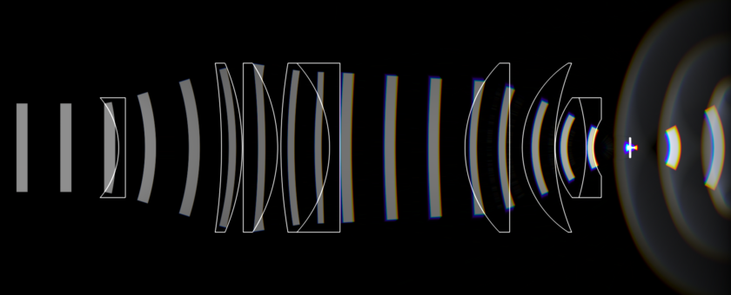
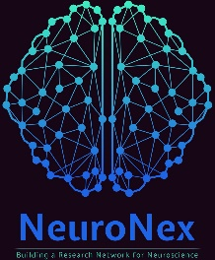
2020 BIG BRAIN IMAGING WORKSHOP
NSF NEURONEX: Next Generation Multi-photon Neuro-Imaging Consortium
Boston University Neurophotonics Center
Towards brain-wide cellular resolution imaging across mammalian species.
Wednesday, April 15th – Thursday, April 16th, 2020
Boston University
Photonics Center, Room 906
8 St. Mary’s Street
INFO AND REGISTRATION
nemonic.ece.ucsb.edu/index.php/Big_Brain
DEADLINE: MARCH 20, 2020
DISTINGUISHED SPEAKERS
Daniel Aharoni UCLA Michele Basso UCLA Adam Charles Johns Hopkins University Anna Devor Boston University David Fitzpatrick Max Planck Institute Florida | Emily Gibson University of Colorado, Anschutz Prakash Kara University of Minnesota Jerome Mertz Boston University Kristina Nielsen Johns Hopkins University Anitha Pasupathy University of Washington | Bijan Perasan New York University Eyal Seidemann University of Texas, Austin Lei Tian Boston University Alipasha Vaziri Rockefeller University Chris Xu Cornell University

